Slide 1
MovieOnRent Data Analysis using SQL - Optimizing Movie Inventory and Customer Experience ANALYZING Motion pictures data USING SQL -A DATA ANALYST’S PERSPECTIVE
BY
Shaik Aayesha Mohammadi
Batch Number: DA132S13
Enrollment ID:EN12024078064

Slide 2
TABLE OF CONTENTS
INTRODUCTION
BUSINESS OBJECTIVE
UNDERSTANDING THE DATA
EACH TASKS & OUTPUTS
ADVANTAGES
DISADVANTAGES
APPLICATIONS
CONCLUSION

Slide 3
INTRODUCTION
This analysis will help Sakila Movie Rental Store to understand what types of movies and actors are most popular among their customers.
By analyzing rental data, we can identify patterns and trends that will help improve inventory management and ultimately, business success,helps us to make informed decisions to improve their business.

Slide 4
BUSINESS OBJECTIVE
The business objective of this project is to leverage data analysis to
Optimize MovieOnRent's operations, enhance customer satisfaction, and boost profitability through informed inventory management, targeted marketing, and the promotion of family-friendly content to a broader audience, particularly young families.

Slide 5
UNDERSTANDING THE DATA
The project involves the usage of most popular database called sakila and utilizing specific columns from multiple database tables to extract valuable insights related to actor details, movie information, rental transactions, and categories to inform business decisions and improve MovieOnRent's operations.

Slide 6
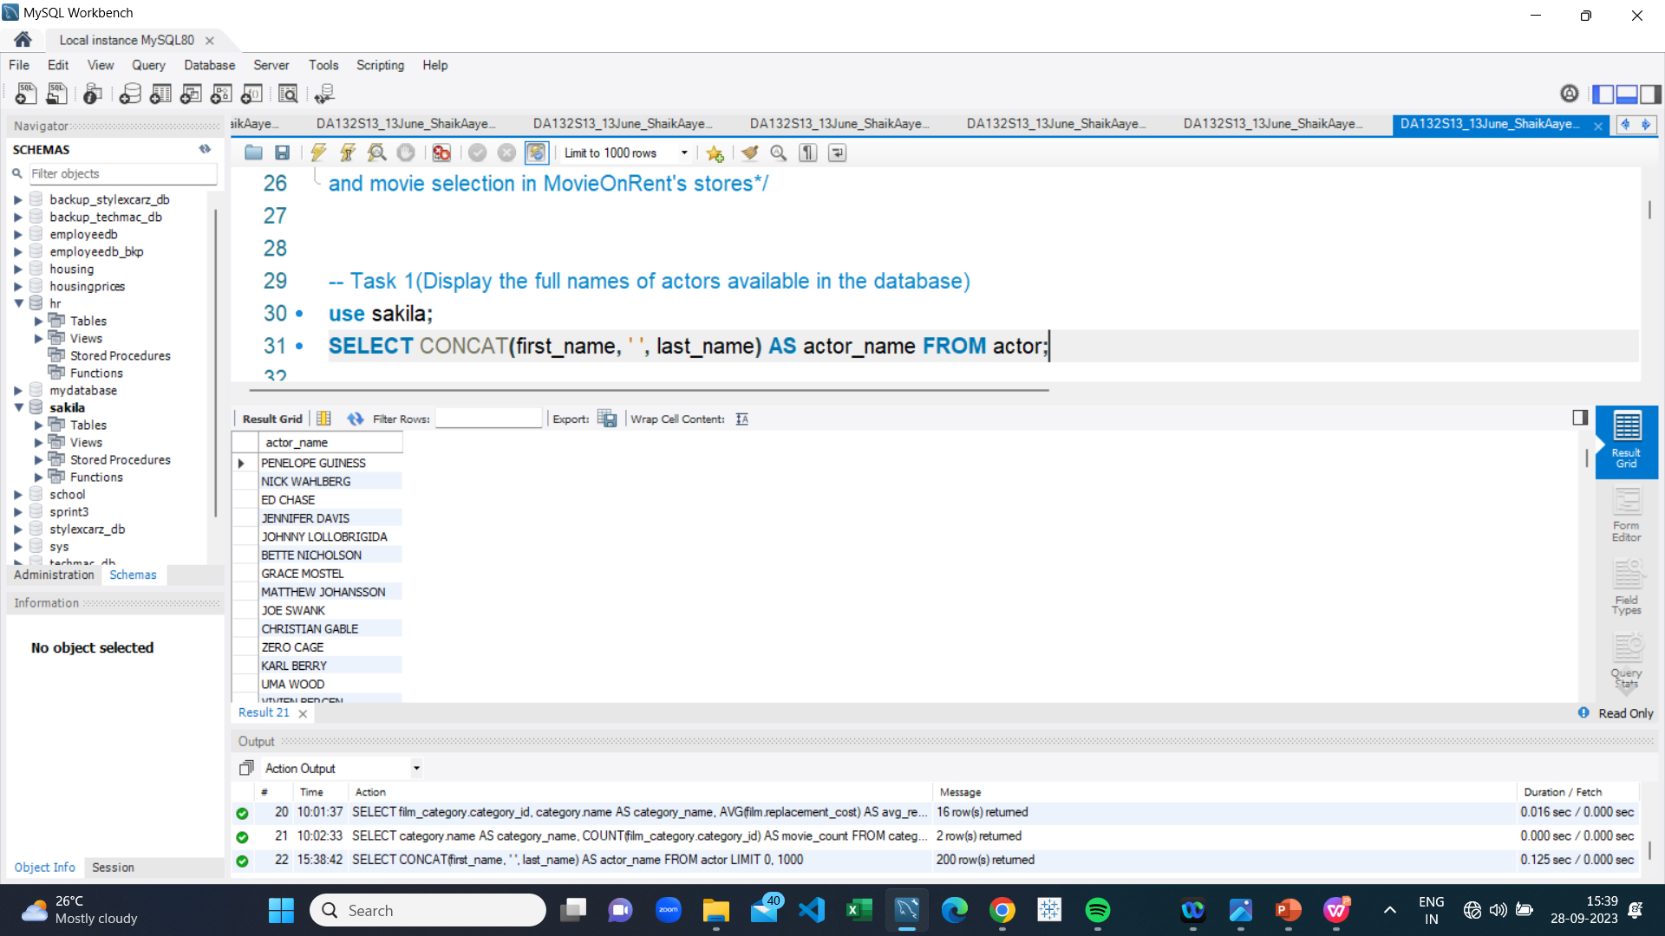
Full names of actors
The result provides the list of actor names
in the format “Actor_Name" ,'PENELOPE GUINESS’

Slide 7
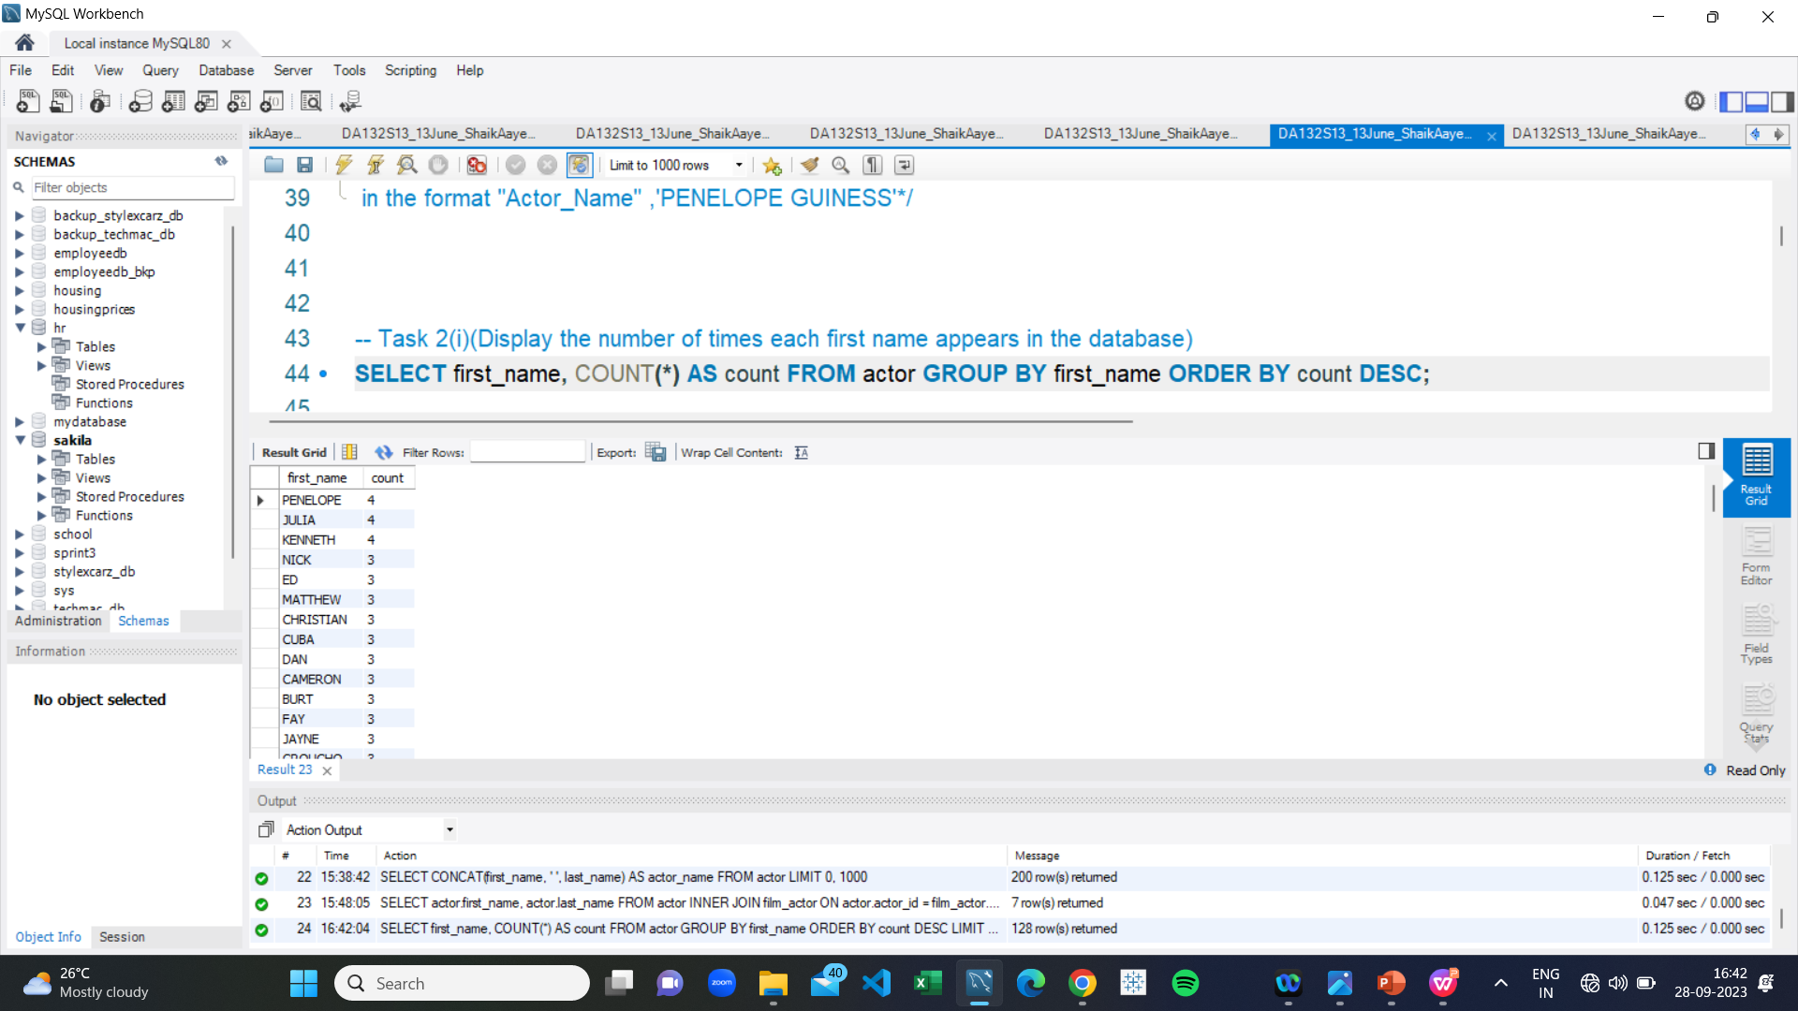
Count of Common first name
The result provides the list of count of unique actor first names and most popular "First Name “ is ,PENELOPE appeared 4 times.

Slide 8
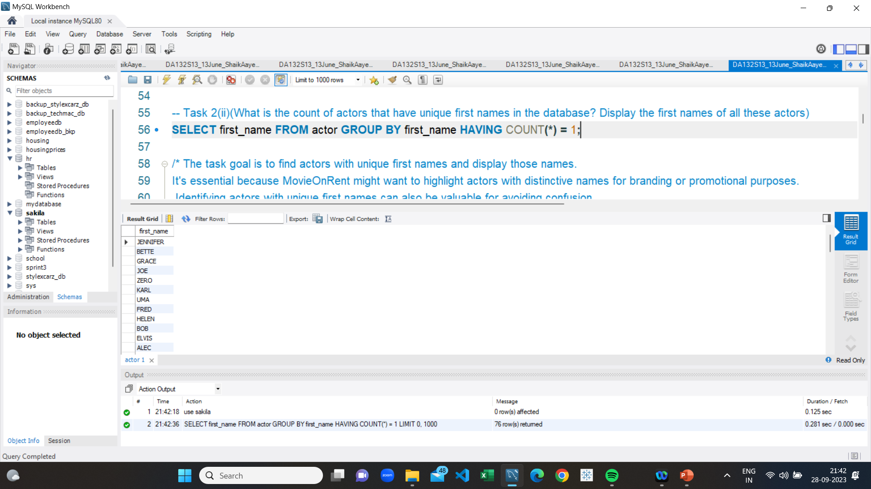
Unique first names
The result provides the list of unique actor first names and most unique "First Name”appeared in the database is ,'JENNIFER’.

Slide 9
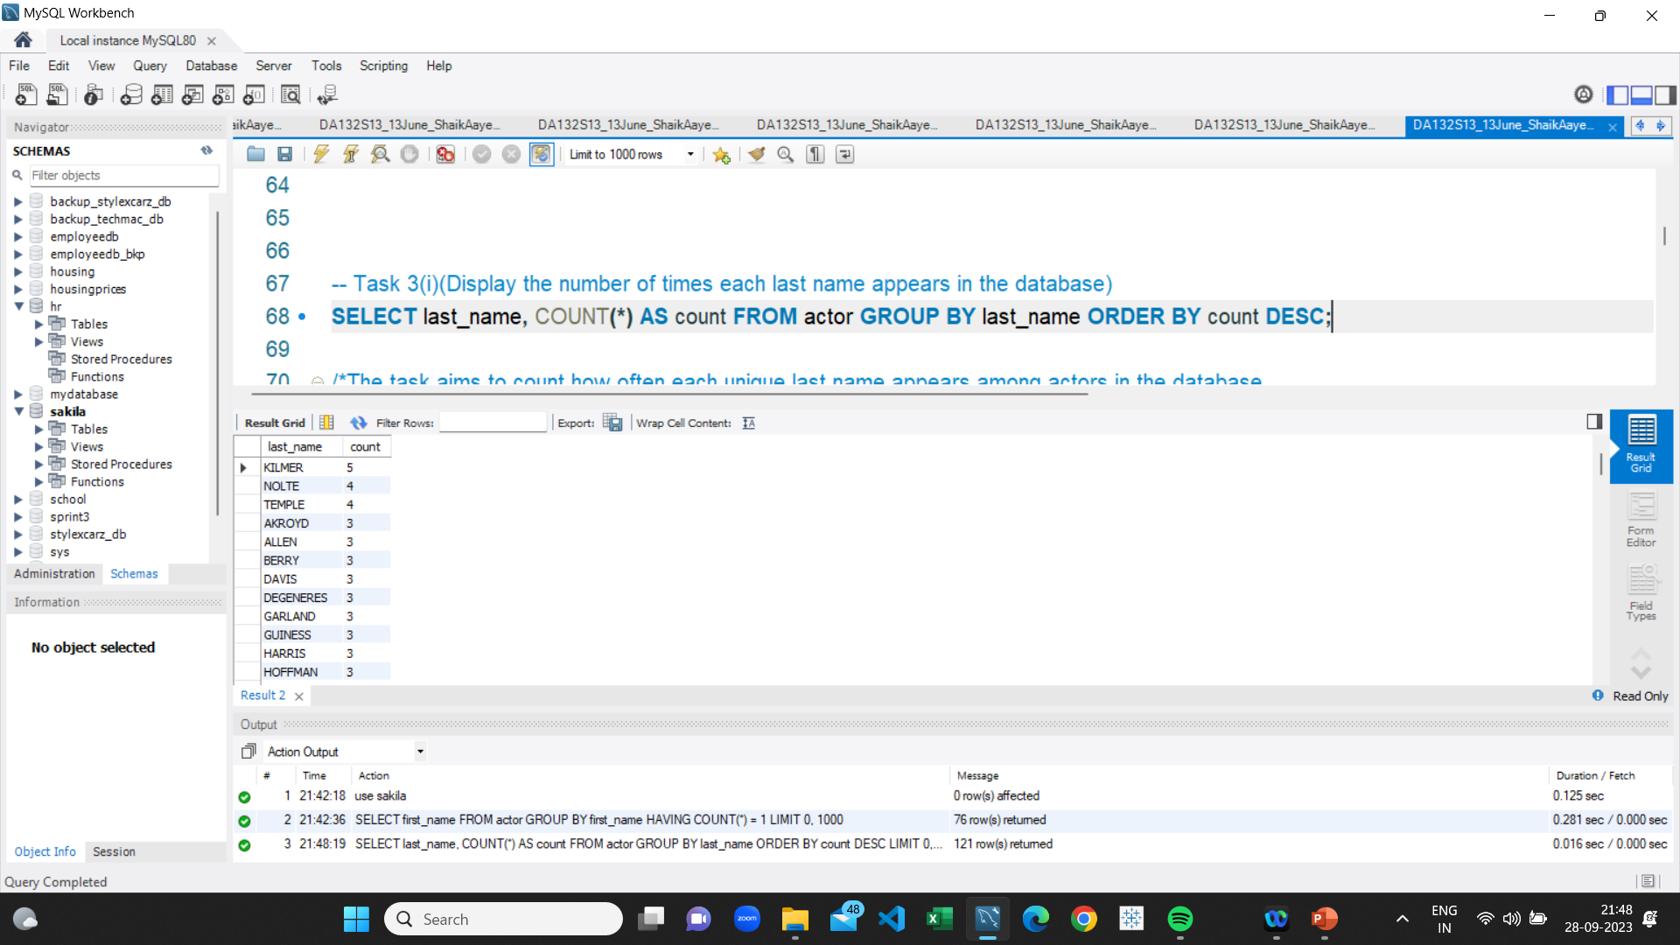
Count of last names
The result provides the number of times each last name appears in the database in the format "Last Name, Count " , and mostly appeared name is 'KILMER 5

Slide 10
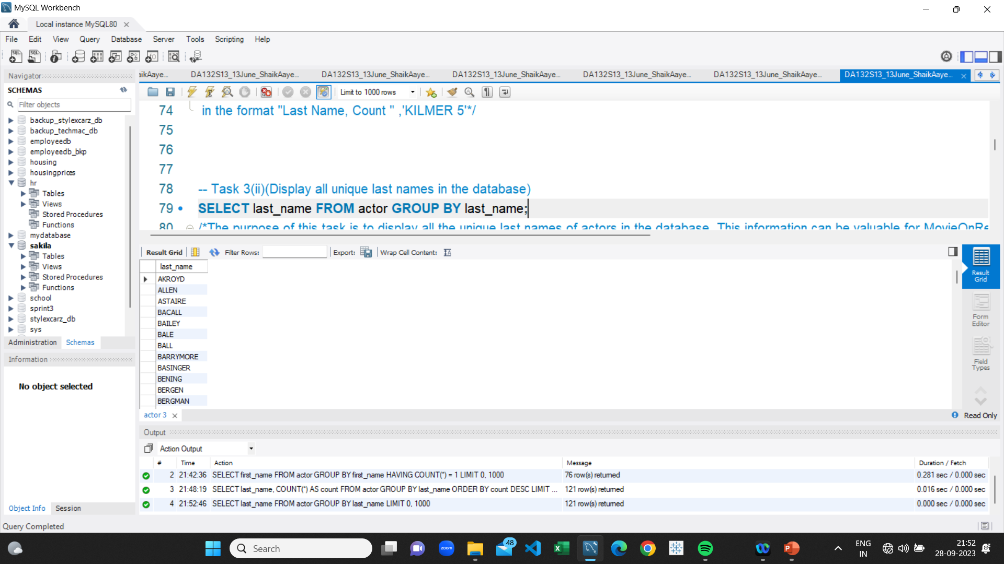
All unique last names
The result provides the list of all unique last names in the database in the format "Last Name" , and most unique name is 'AKROYD'

Slide 11
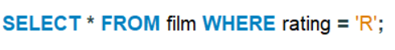
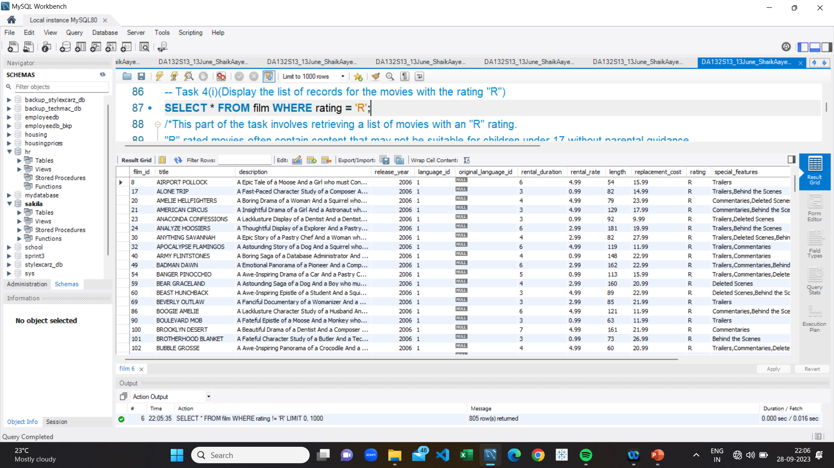
Movies with the rating "R"
The result provides the list of records for the movies with the rating "R" and movies like AIRPORT POLLOCK Title has "Rating" , ‘R’.

Slide 12
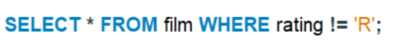
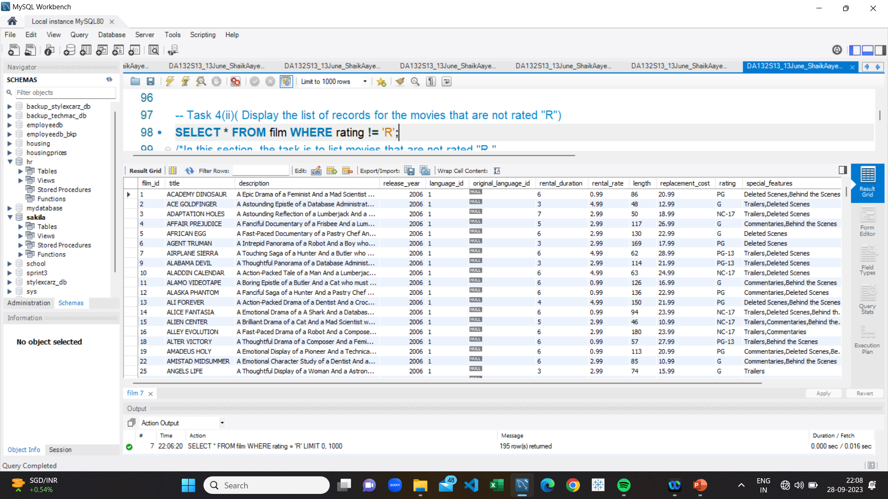
Movies with a non-R-rating
The result provides the list of records for the movies that are not rated "R“. Movies like ACADEMY DINOSAUR Title has "Rating"
,'PG-13' , 'NC-17’

Slide 13

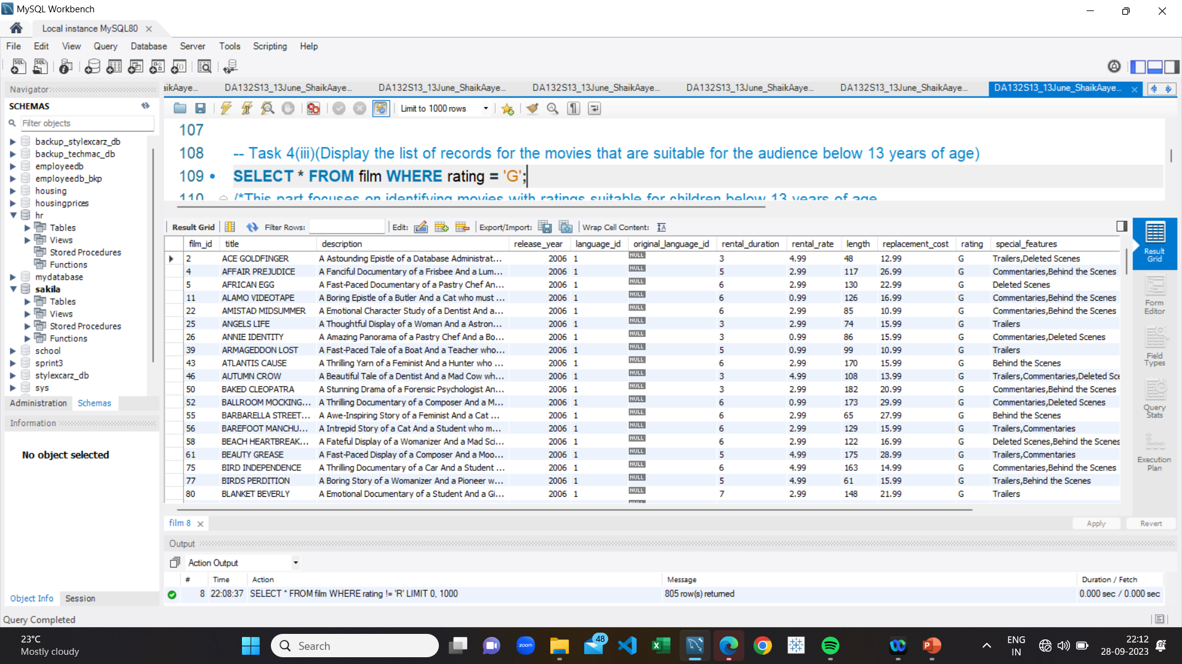
Movies suitable for kids under 13 years of age
The result provides the list of records for the movies with the rating "R" in the format Title and respective columns along with "Rating" , 'G' with movie title 'ACE GOLDFINGER’

Slide 14
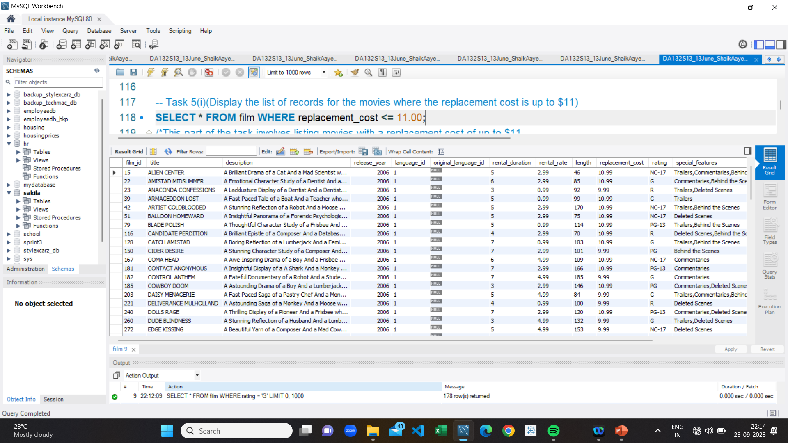
Movies with replacement cost up to $11
The result provides the list of records for the movies where the replacement cost is up to $11 in the format Title and respective columns along with "replacement cost" below 11 10.99,9.99 with movie title 'ALIEN CENTER’

Slide 15
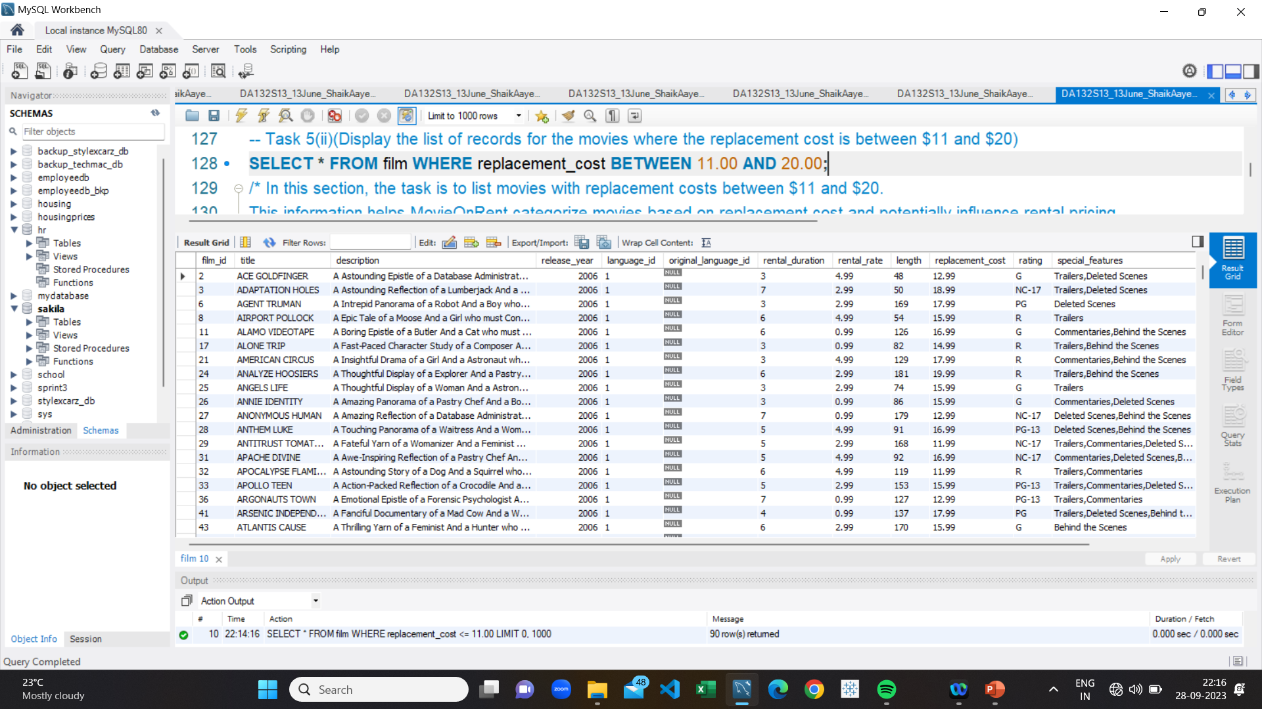
Movies with replacement cost between $11& $20
The result provides the list of records for the movies where the replacement cost is BETWEEN $11 TO $20 in the format Title and respective columns along with "replacement cost" between 11 to 20 17.99,18.99 with movie title 'ACE GOLDFINGER’

Slide 16
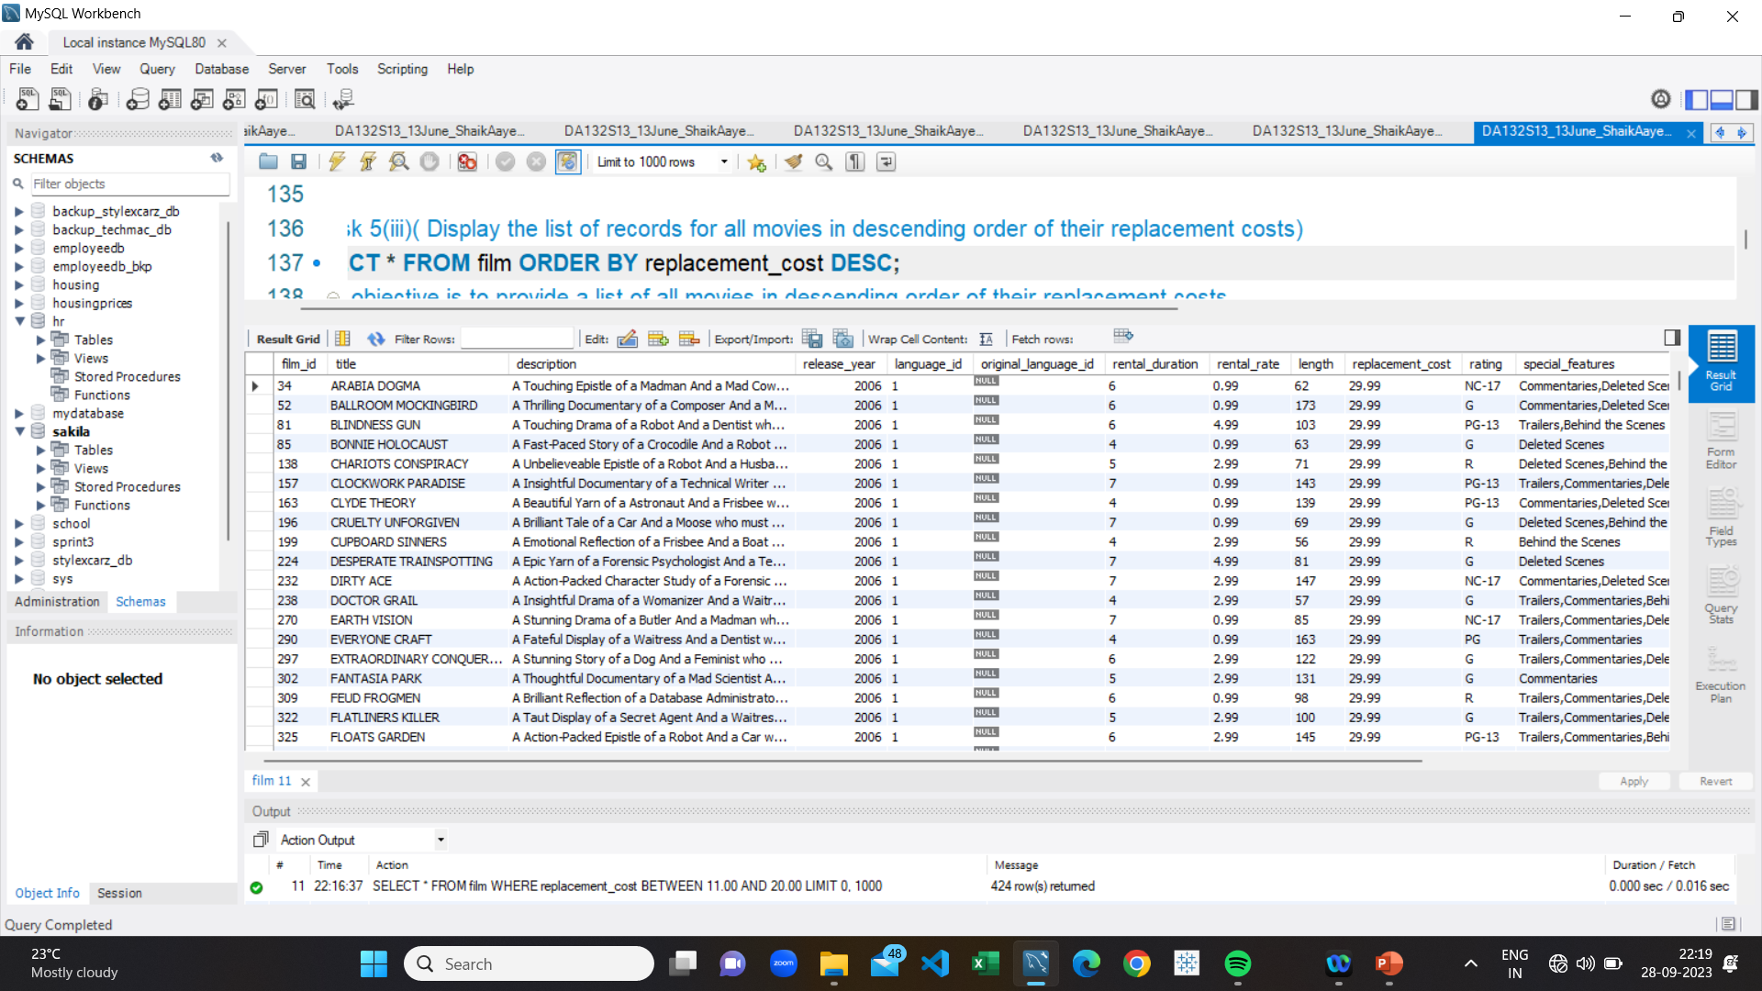
Movies with highest replacement cost
The result provides the list of records for all movies in descending order of their replacement costs in the format Title and respective columns along with "replacement cost" between 30 to 9 27.99,9.99 with movie title 'ARABIA DOGMA’

Slide 17
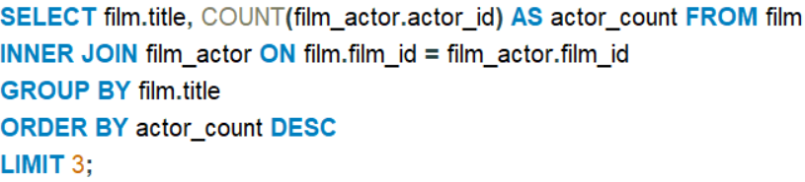
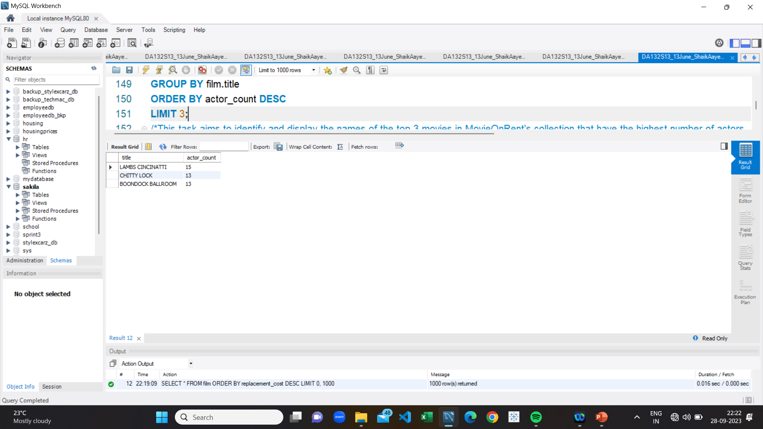
Top 3 movies & number of actors
The result of this query will be the names of the top 3 movies
with the greatest number of actors in the format
"Title, Actor_Count " ,''LAMBS CINCINATTI 15’,
'CHITTY LOCK 13','BOONDOCK BALLROOM 13’
The result provides
the names of the top 3 movies
with the greatest number of
actors in the format
"Title, Actor_Count " ,and
''LAMBS CINCINATTI is having highest count of 15’.

Slide 18
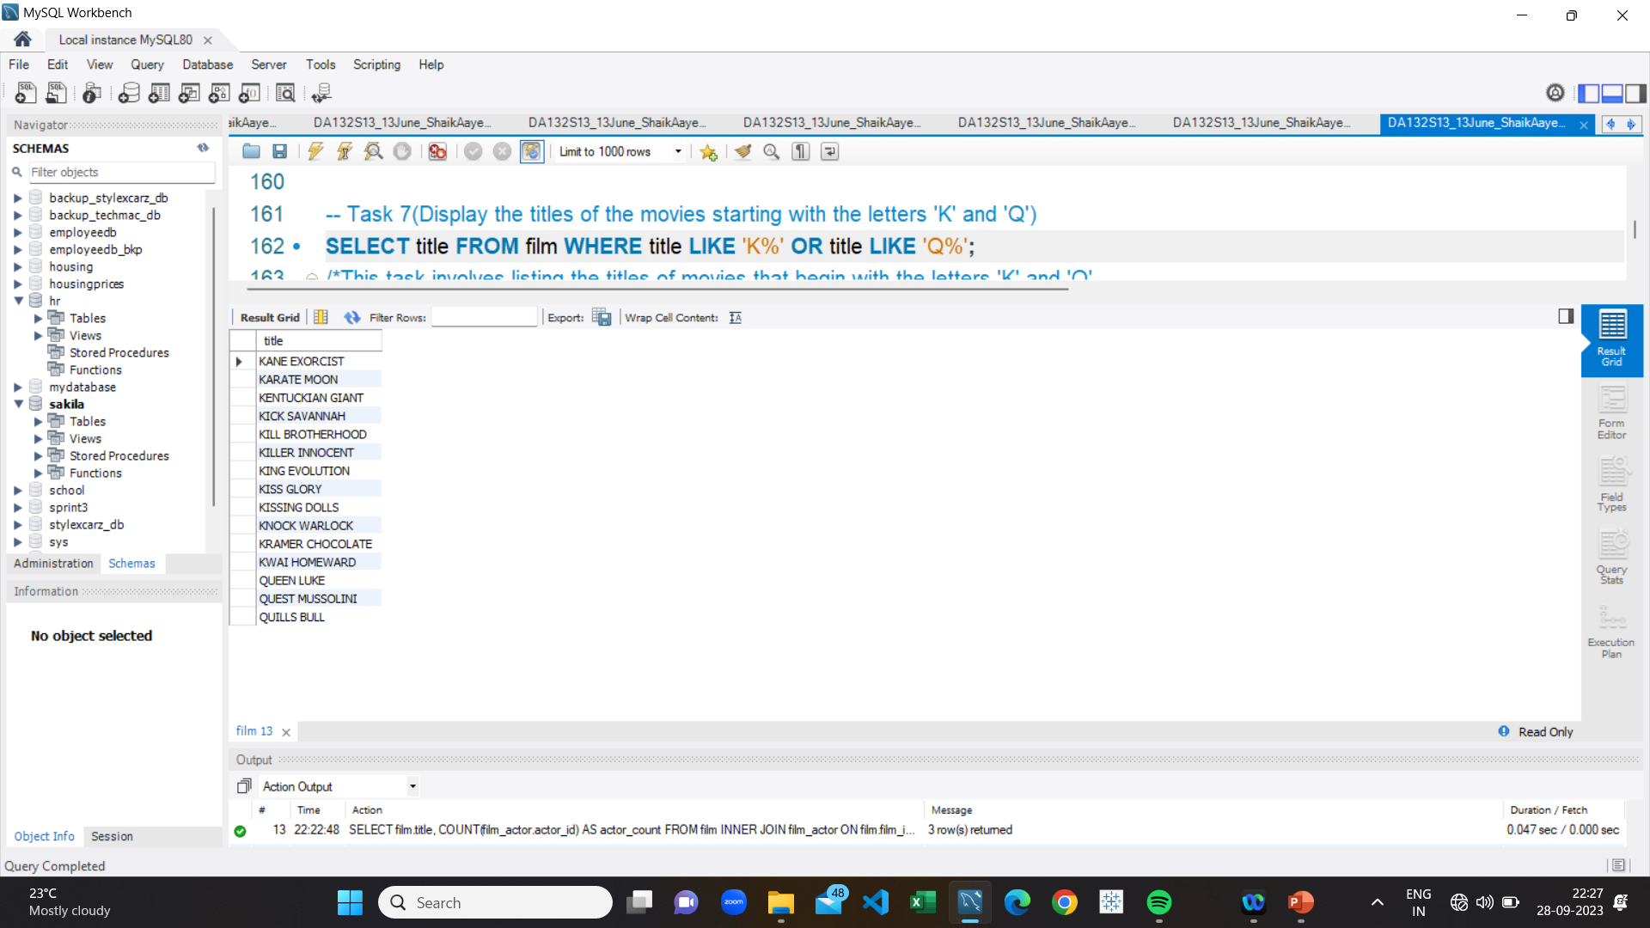
Movies with letters 'K’ & 'Q'
The result provides the titles of the movie
starting with the letters 'K' and 'Q’ in the format
"Title",'KANE EXORCIST'

Slide 19
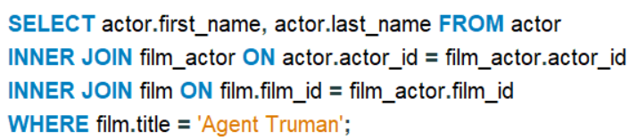
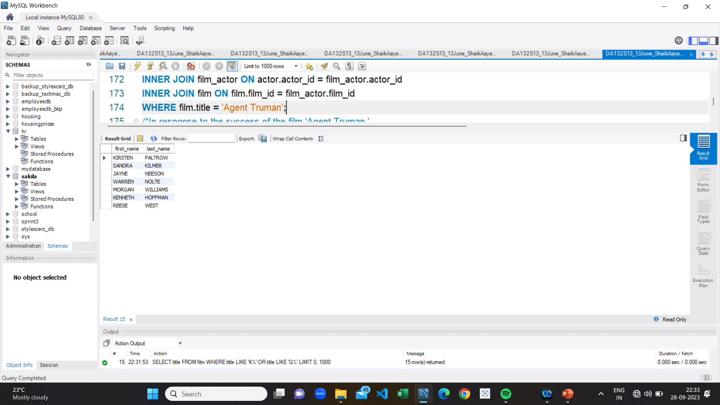
Actors who appeared in 'Agent Truman'
The result provides the names of all
actors who appeared in the film 'Agent Truman’
in the format "First_name Last_name",
'KIRSTEN PALTROW'

Slide 20
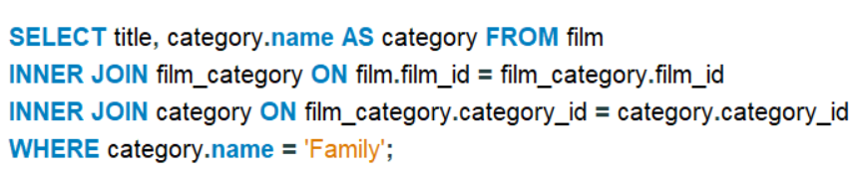
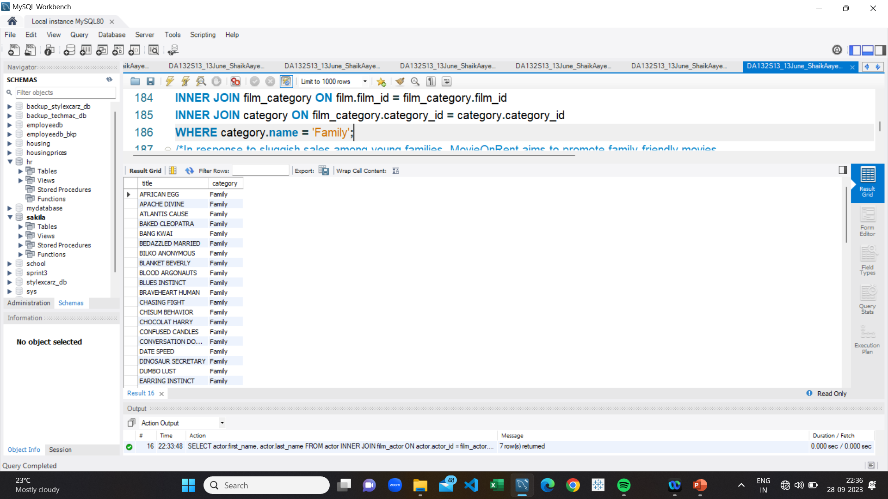
Family films
The result provides the movies categorized
as family films in the format
"Title Category",''AFRICAN EGG' 'FAMILY'

Slide 21
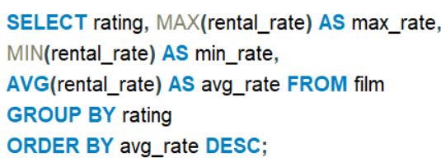
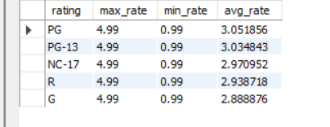
Rental rates of movies
The result provides the maximum, minimum,
and average rental rates of movies based on their ratings
in the format "Rating,"max_rate","min_rate","avg_rate“.

Slide 22
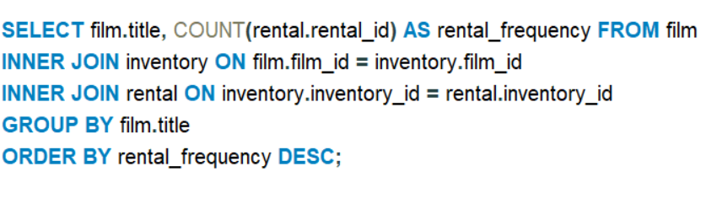
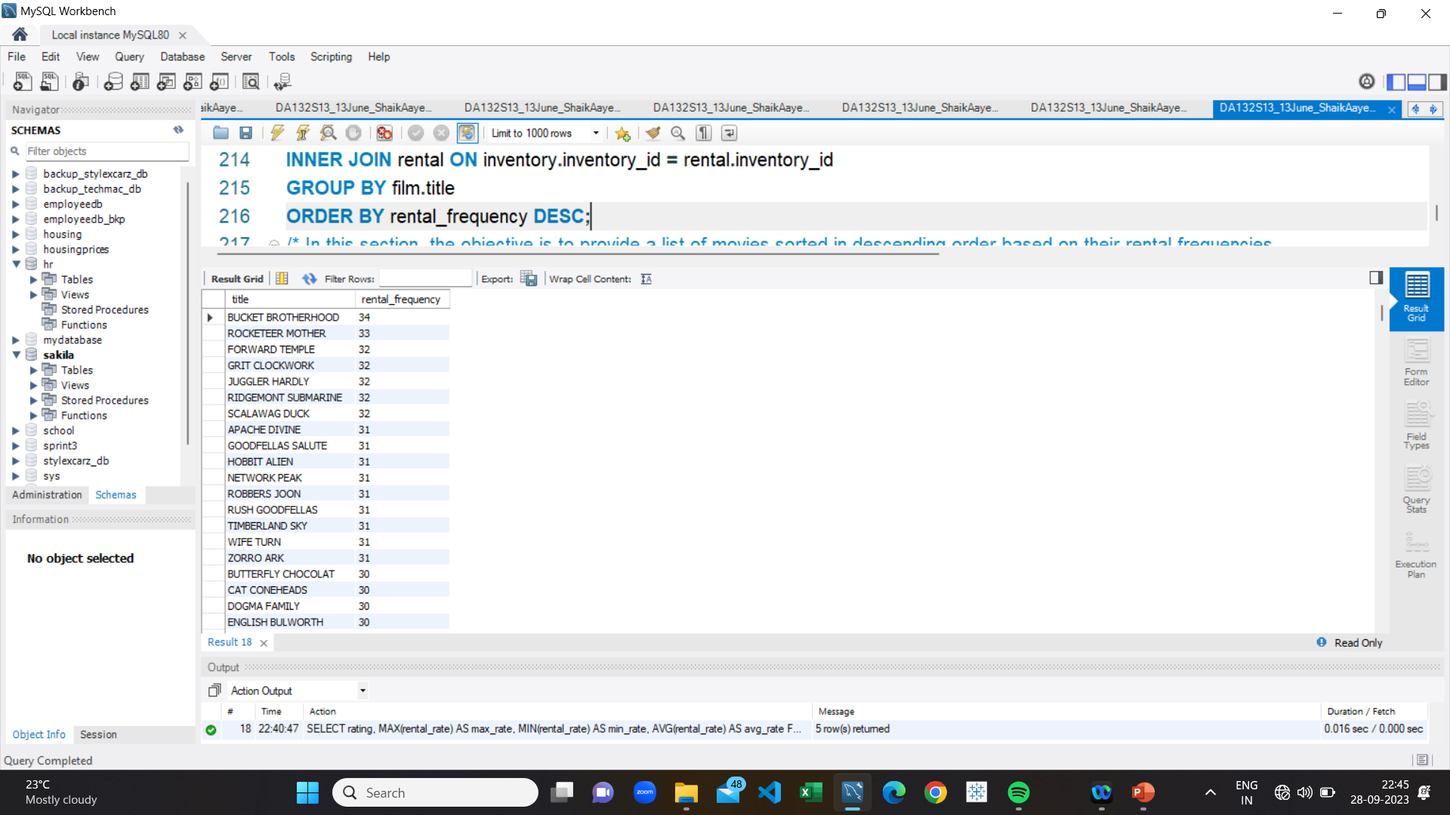
Rental frequencies
The result provides the movies in descending order of their rental frequencies in the format "Title, Rental_frequency " ,
''BUCKET BROTHERHOOD' '34’

Slide 23
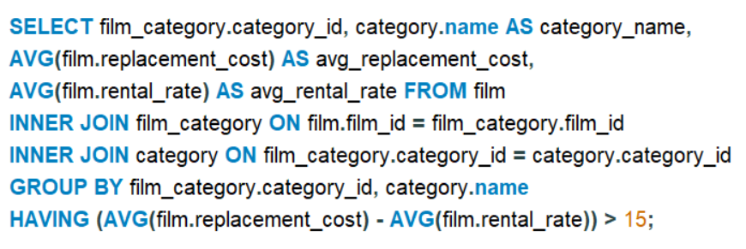
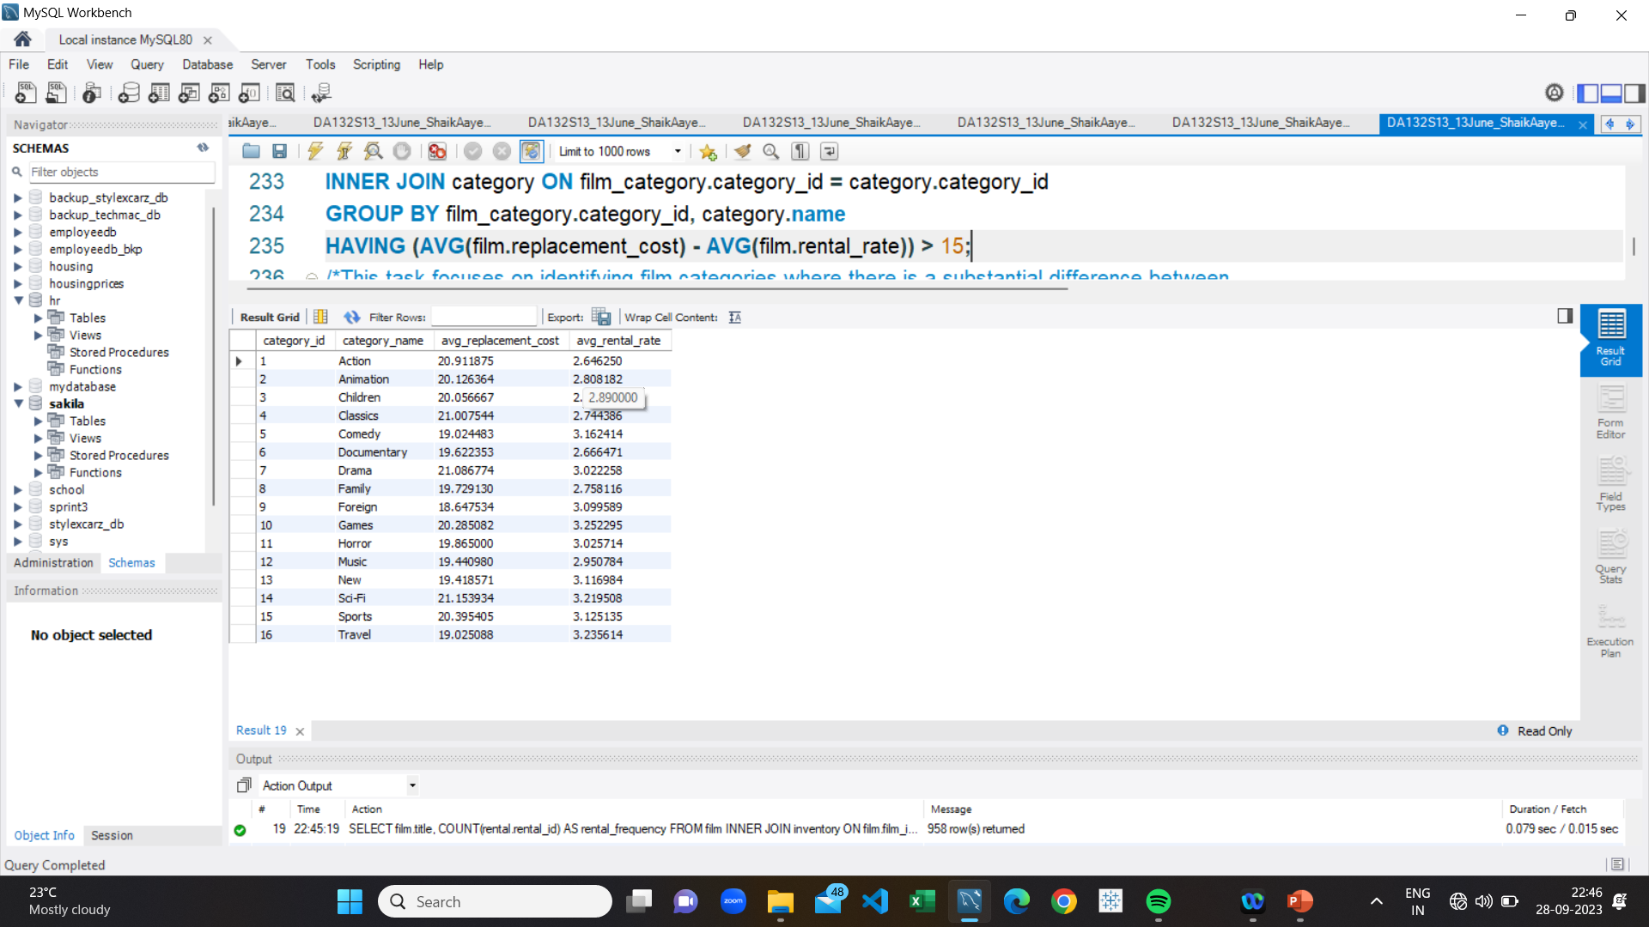
Difference between replacement cost & rental rate
The result provides the film categories with
a significant difference between replacement cost
and rental rate in the format "categoty_id’,
'Category_name','avg_replacement_cost’,
'avg_rental_rate' ,'16','Travel',''19.025088'' ''3.235614''

Slide 24
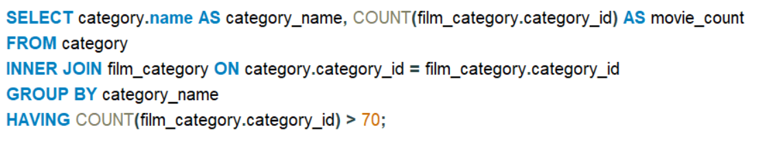
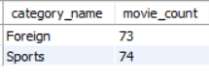
Categories with more than 70 movies
The result provides the film categories with a significant difference between replacement cost and rental rate in the format 'Category_name','Movie_count','Foreign 73','Sports 74’

Slide 25
ADVANTAGES
Improved decision-making
Increased profitability
Better audience engagement
Improved content quality
Competitive advantage

Slide 26
DISADVANTAGES
Limited scope
High cost
Time-consuming
Overreliance on data
Privacy concerns

Slide 27
APPLICATIONS
Audience analysis
Box office predictions
Script analysis
Talent identification
Marketing optimization

Slide 28
CONCLUSION
MovieOnRent can improve its business by strategically adjusting pricing for movies, promoting family-friendly content, and capitalizing on top-rated genres and actors.
This approach is likely to increase sales, enhance customer satisfaction, and expand the audience base, particularly among families. Family and children-friendly movies such as "AFRICAN EGG" fall under this category, along with top-rated films like "LAMBS CINCINATTI" and "KANE EXORCIST."

Slide 29
THANK YOU

